Slide 1
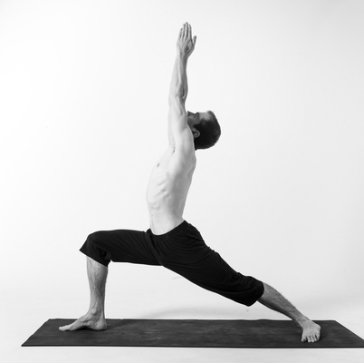
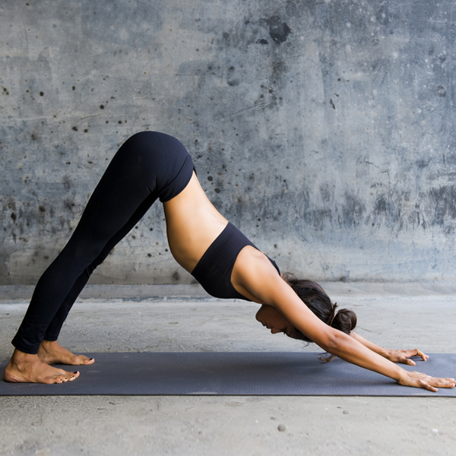
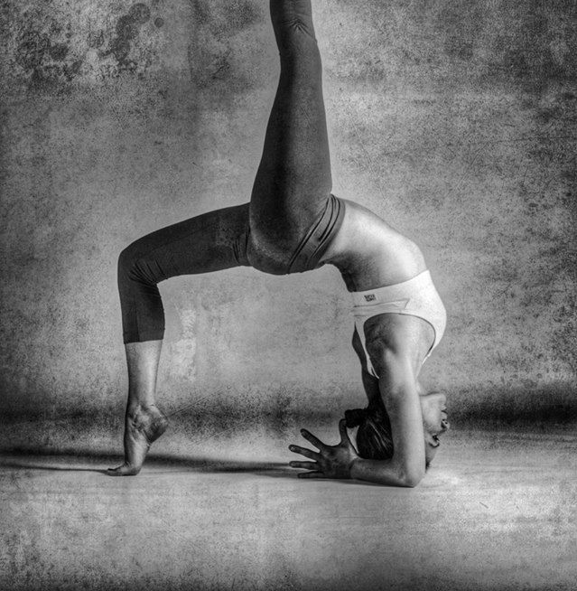
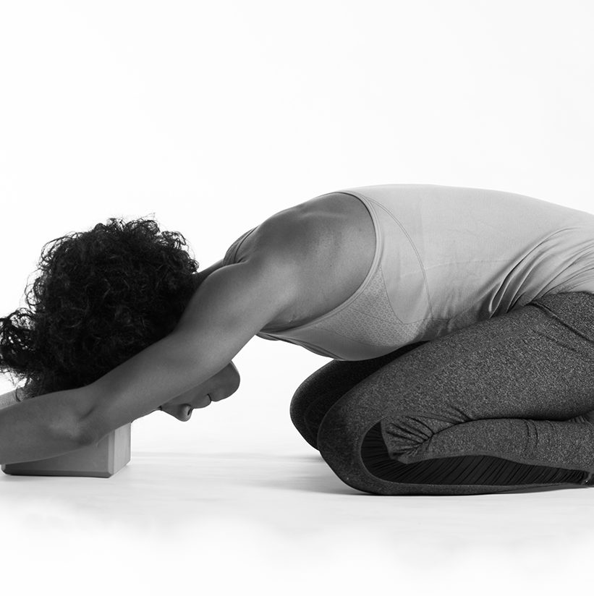
Recognition of Yoga postures from Images using Deep learning
by
Sriranjani Sridharan (R00182510)
MSc in Artificial Intelligence, Cork Institute of Technology
May 2020
26/05/2020

Slide 2
Outline
Introduction
Research Aim and Objective
Motivation
Background and Related Work
Proposed Approach
Methodology
Evaluation
Results and Observations
Conclusion
Future Work
References
26/05/2020

Slide 3
Introduction
Computer Vision is a field in AI that focuses on understanding and interpreting the visual world.
Aims to process and analyze electronically available visual data such as images and videos to reconstruct properties such as shape, color and brightness.
Works with numerical information(pixels) and applies a combination of mathematical functions, theories and methods for construction of decision models or systems.
Addresses key tasks such as object detection, face recognition, scene understanding, image restoration and human activity recognition.
26/05/2020

Slide 4
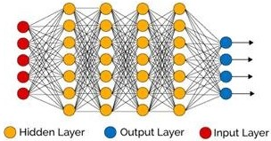
Introduction
Deep Learning is a core method used in the field of Computer Vision that structures algorithms in layers to depict an artificial neural network (mimicking the way the human brain works). Learns from abstract representations.
The model is trained iteratively by assigning weights to the features from the data and updating it using standard back-propagation algorithms
Has numerous variants of model architectures such as Convolutional neural networks(CNNs), Deep Belief Networks, Recurrent Neural networks, Stacked Autoencoders and Deep Boltzmann Machines.
26/05/2020

Slide 5
Research Aim and Objective
Human activity recognition is an interesting and challenging computer vision problem, studied by researchers for many years.
Its application has shown a great potential in the ﬁeld of multimedia, surveillance, dance choreography, physical training, and Virtual reality.
The exploration in the ﬁeld of yoga has just started to gain its pace.
The goal is to build a deep learning model to recognize 10 diﬀerent yoga postures or asanas from images.
The diﬀerent yoga postures or classes used for classiﬁcation were bridge, child’s pose, downward dog, mountain, plank, seated forward, tree, triangle pose, warrior1 and warrior2.
Considering the small size of the data, the impact of using CNN built from scratch and its variant using transfer learning were studied.
26/05/2020

Slide 6
Motivation
Advancements in computer vision and multimedia related techniques led to automatic or semi-automatic ﬁtness training systems to help people involved in a rapidly moving lifestyle.
Yoga is a form of practice that boosts physical health and help to cleanse the body, mind, and soul.
Self-training systems for practicing yoga can spread its beneﬁts and gain popularity while ensuring that it is practiced correctly.
The proposed system is a start to developing a complete self training system that can be used as an application or tool by beginners to practice yoga at the comfort of their homes.
26/05/2020

Slide 7
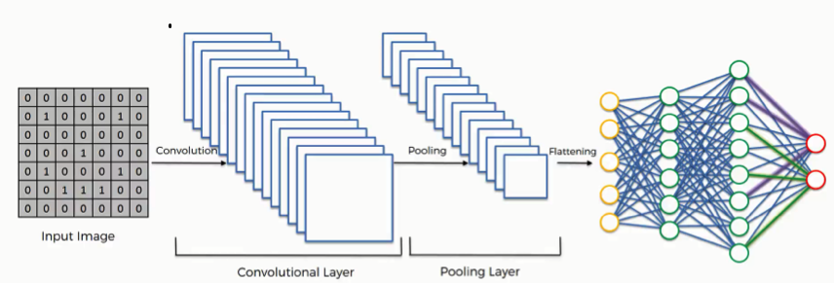
Background and Related Work
Convolutional Neural Networks (CNN)
A variant of Deep learning networks built using kernels, filters and neurons.
Processed based on learnable parameters such as weights and biases.
Contains Convolutional, pooling and fully connected layers.
26/05/2020

Slide 8
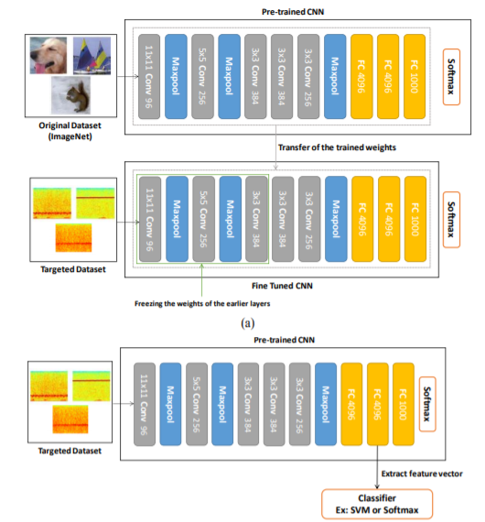
Background and Related Work
Transfer Learning
Applying previously learnt knowledge to assist in learning new knowledge through similarity and connection.
A CNN model that was trained on one problem is used in some way or another related problem.
Best suited approach for small data
Models-VGG16, ResNet, MobileNet etc.
Two Approaches:
-Feature Extraction
-Fine Tuning
26/05/2020

Slide 9
Background and Related Work
Reference | Proposed | Findings
Yoga Recognition
Trejo et al. IEEE, 2018 | A yoga self training system using Adaboost algorithm . Trained by an expert yoga trainer resulting in an accuracy of 94.78% | Drawback - Images for training the model captured using depth sensor-based camera
Chen et al. Springer, 2018 | A yoga self training system that assists in rectifying yoga postures when practiced using a Kinect depth camera | Drawback – High computational costs. Involves manual feature extraction and building an individual model for each asana
Yadav et al. Springer, 2019 | Yoga posture recognition from Realtime videos using OpenPose and hybrid deep learning model of CNN and long short-term memory(LSTM) | Reported excellent accuracy (98%) , by using OpenPose to extract the pose information from the data
Classification method
Kieffer et al. IEEE, 2017 | Histopathology Image Classification using training from scratch vs. pre-trained networks | Proves the efficiency of Transfer Learning using a very small dataset
Reddy et al. IEEE, 2019 | Malaria cell-image classiﬁcation with pretrained model ResNet-50 | Reported 95% accuracy and brings down model building and computational time
26/05/2020

Slide 10
Proposed Approach
A classification system was built to recognize 10 different Yoga postures or asanas from images by combining human pose estimation technique – OpenPose and deep learning CNN.
Overall image recognition process is divided into 3 main stages; Pose Estimation using OpenPose, Data augmentation and Classiﬁcation using CNNs.
OpenPose was used to highlight the key features for training the model.
Data Augmentation was used to enlarge our small dataset for the training process.
Classification using CNN built from scratch and using pre-trained models (transfer learning) feature extraction and fine tuning was studied.
26/05/2020

Slide 11
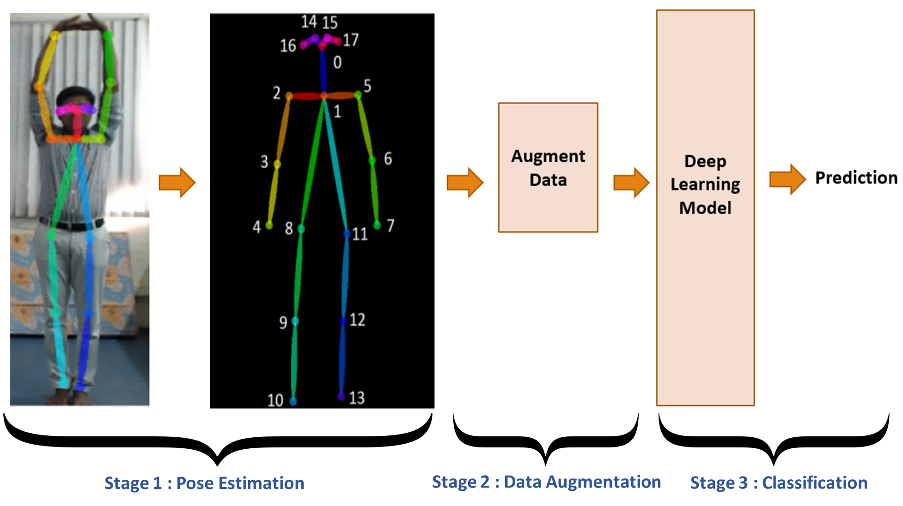
Proposed Approach
26/05/2020

Slide 12
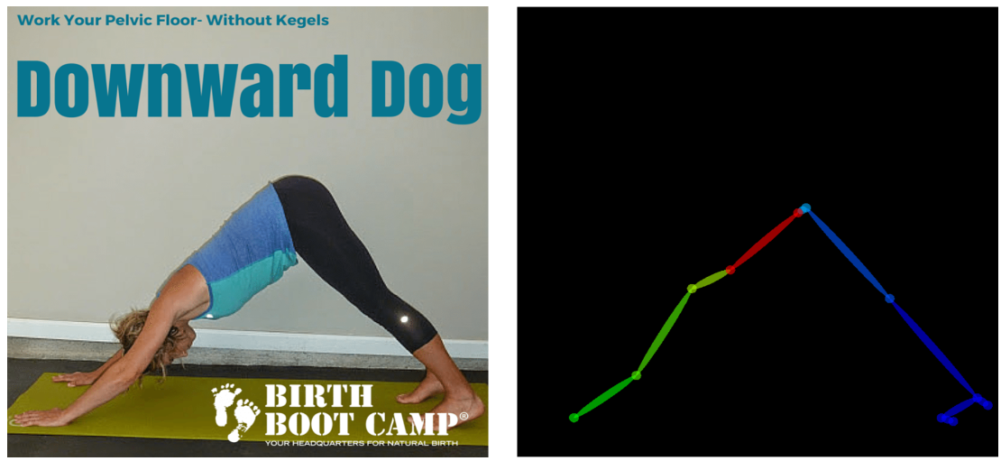
Methodology
Stage 1: Pose Estimation
OpenPose is a system developed by Carnegie Mellon University to jointly detect human body and hand key-points on images.
It adopts an algorithm that recognizes human body parts and generates a frame with skeletal marks that can be used to train a deep learning model to predict various asanas.
It helps to improve the classiﬁcation process by removing unwanted background noise in images.
26/05/2020

Slide 13
Methodology
Stage 2: Data Augmentation
The amount of data to be used to train the model plays a very important role.
Augmentation is necessary when dealing with a small set of images for the training process and to improve generalization performance.
Keras library data augmentation functions were used to ﬂip, re-scale and zoom an image and create an augmented set of images from the OpenPose generated images.
Increases the size of the training set and improve the model performance to generalize between the postures.
The first two stages constitute to the pre-processing of data.
26/05/2020

Slide 14
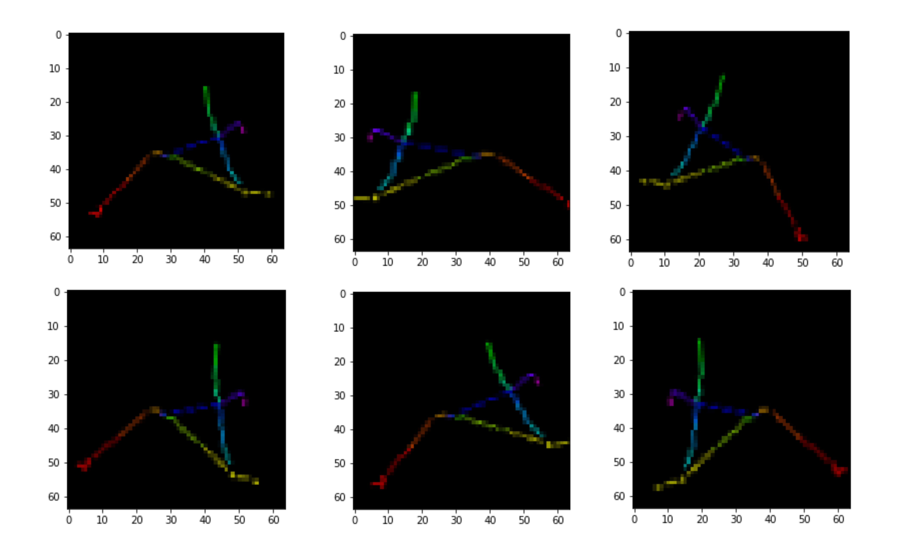
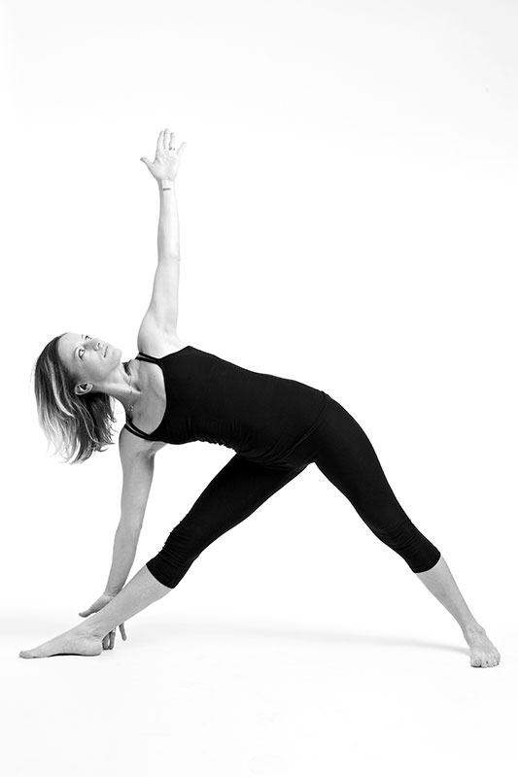
Methodology
Stage 2: Data Augmentation
26/05/2020

Slide 15
Methodology
Stage 3: Classification
The front end tool Keras, makes it easier to build CNNs and incorporate pre-trained CNNs with a lot of readily available supporting functions.
The main challenge is to train the model by tuning a set of parameters that would learn at its best from the given data. Example – Iterations, No. of layers etc.
Another challenge is Overfitting. It is phenomenon, where a network learns a particular function with very high variance so that it can perfectly model the data.
Overﬁtting can lead to poor model performance especially with small data.
The final output from the model is a set of probabilities of the image belonging to the 10 classes. The maximum probability determines its classification.
26/05/2020

Slide 16
Methodology
Handling Overfitting
Data Augmentation, L1/L2 Regularization and Dropout are some methods to handle overfitting.
L1/L2 Regularization
While iterating through a network, some of weights tend to become quite large where it starts to overﬁt the data.
Reduces the magnitude of the weights that is being updated. This study uses L2 as suggested in Andrew Ng’s paper (2004) .
Dropout
Randomly turns some of the neurons in a layer to be inactive based on a threshold probability parameter.
Reduces input dependencies between layers and improves generalization.
26/05/2020

Slide 17
Methodology
Conventional CNN
Parameters will be tuned to design a better performing model and all the layers are trainable.
Transfer learning based CNN
The pre-trained models MobileNet, VGG16, VGG19, Xception and ResNet50 were used in this study.
Diﬀerence between the models is in the architecture or depth of the hidden layers.
Feature extraction and fine tuning approach was studied with selected pre-trained models.
The final layers of the classifier that was tailored for the current task include fully connected layers and a SoftMax layer.
26/05/2020

Slide 18
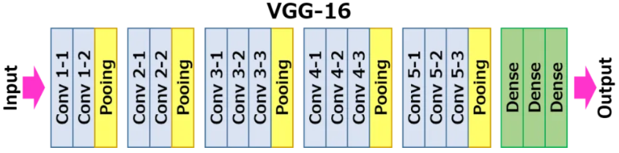
Methodology
Transfer Learning Based CNN – Usage Example
Feature Extraction
Fine Tuning
Frozen pre-trained Weights
Trainable Weights
26/05/2020
Frozen pre-trained Weights
Trainable Weights

Slide 19
Evaluation
Dataset
Retrieved from Dataset Source.
Contains a total of 712 images that captured people doing 10 diﬀerent yoga postures.
The images were not captured with restricting backgrounds and hence will be cluttered in factors such as attire, background color, gender, age etc.
Dataset Cleansing
There was an imbalance or inconsistency in the images between a few classes.
It contained a few images that were ﬂipped and hence were redundant to the original image.
Redundant images were removed to maintain consistency.
26/05/2020

Slide 20
Evaluation
The OpenPose framework was setup using based on Setup Instructions and the images were processed against it.
The generated OpenPose images were evaluated over an 80%-20% train and test split (without replacement) with 5-Fold cross validation.
The below parameters were tuned for the classification process.
Parameter | Indicates
Network Architecture | Conventional CNN model or the Transfer learning model
Epochs | Number of iterations for which the network will update itself and learn from the data.
No. of Hidden Layers | Number of fully connected layers before the ﬁnal SoftMax layer
Learning Rate | Step size in each iteration while moving towards minimizing the loss function.
Regularization parameter | Model with and without L2 regularization was studied
Dropout | Model with and without Dropout was studied
26/05/2020

Slide 21
Evaluation
Evaluation Criteria
Model accuracy on the test set - the ratio of correctly classiﬁed images over the total number of images. (Ideally should be high)
Model loss on the test set – indicates how well the model has learnt to perform this image recognition task. (Ideally should be low)
Conventional CNN Experiments
A set of experiments was executed based on the different parameter settings without Dropout or Regularization
The same set of experiments were repeated with L2 Regularization and with Dropouts individually.
Transfer Learning based CNN Experiments
Initially evaluate the selected pretrained models with feature extraction and Fine tuning.
The best model is fine tuned with the previously discussed parameters.
26/05/2020

Slide 22
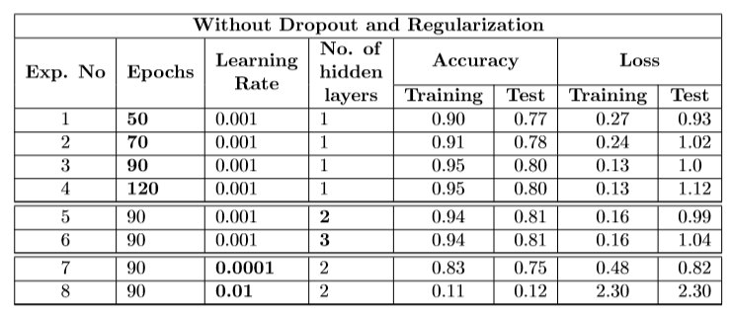
Results and Observations
Results from Conventional CNN without Dropout and Regularization
Overfitting observed - training accuracy is high but the test accuracy is quite low. The loss is also quite high.
26/05/2020

Slide 23
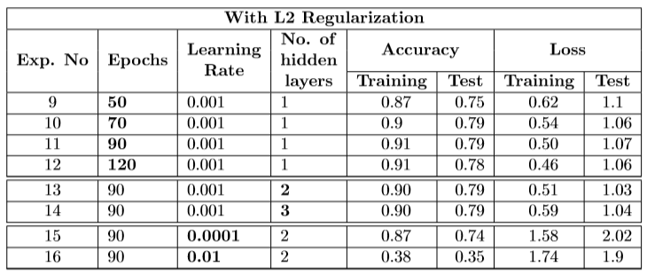
Results and Observations
Results from Conventional CNN with Regularization
Overfitting reduces, however no improvement in test accuracy and loss.
26/05/2020

Slide 24
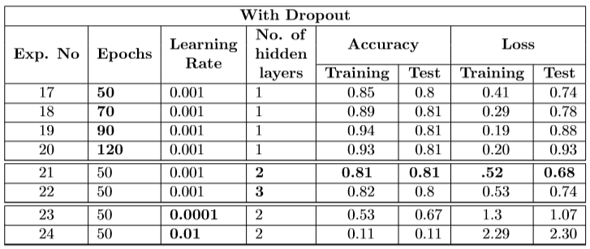
Results and Observations
Results from Conventional CNN with Dropout
Overall improvement in test accuracy and loss
26/05/2020

Slide 25
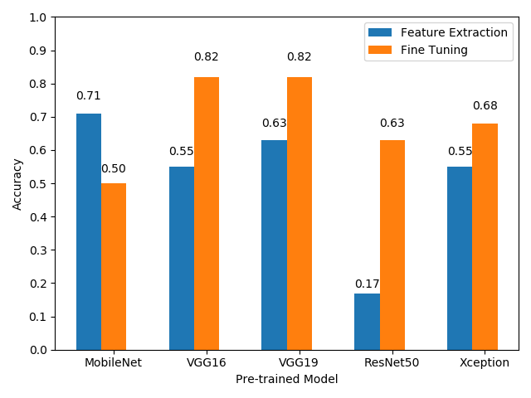
Results and Observations
Results from Transfer Learning based models
Fine tuning approach is better than feature extraction approach, for all the models except MobileNet.
VGG16 and VGG19 reports best accuracy at 82%.
Break ties with lowest validation loss, VGG16 loss=0.73, VGG-19 loss=0.86
26/05/2020

Slide 26
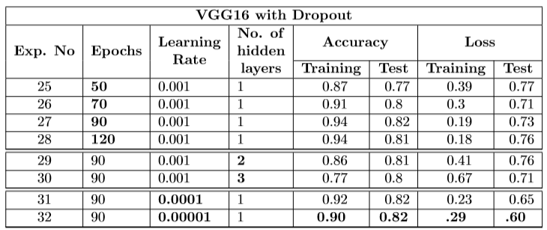
Results and Observations
Results from fine tuning VGG16 with Dropout
The experiment no.32 is the best performing model in this study.
Reported the highest possible accuracy of 82% and the lowest loss of 0.60.
26/05/2020

Slide 27
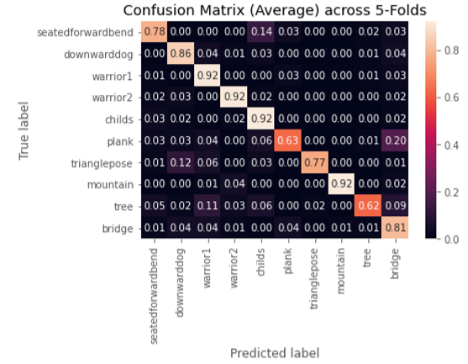
Results and Observations
Confusion matrix for the best performing model
The higher density across the diagonal indicate that most of the yoga postures were predicted correctly.
The plank and tree postures show a comparatively higher number of mis-classiﬁcations leading to the accuracy of 82%.
26/05/2020

Slide 28
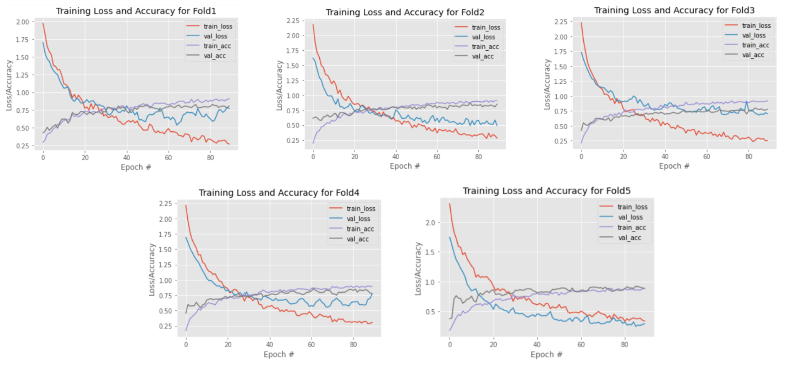
Results and Observations
Snapshot of how accuracy and loss varies over Epochs
26/05/2020

Slide 29
Conclusion
The results from both the conventional and transfer learning approach seemed to converge closely around the same performance level with the latter having a slight edge in outperforming the former.
The transfer learning model using VGG16 reported the best results achieving an accuracy of 82%. There is room for improvement.
The overall system is constrained by the quality of pose estimation using OpenPose.
OpenPose fails to detect feature key-points in cases of hidden or overlapping body parts.
For any new posture to be added to the classification, the model can be easily retrained by adding an additional neuron to the ﬁnal network layer (SoftMax layer)
26/05/2020

Slide 30
Future Work
Alternative approaches for pose estimation such as Dense Pose and PersonLab.
Evaluating with a diﬀerent set of yoga postures to see how the model learns the diﬀerent arrangement of features from the images.
Using Ensemble neural network models for the classiﬁcation process.
In Ensemble networks, the variability is induced with the behavior of multiple network architectures on the same data.
26/05/2020

Slide 31
References
Shukla, Rati & Yadav, Vikash & Pal, Parashu & Pathak, Pankaj. (2019). Machine Learning Techniques for Detecting and Predicting Breast Cancer.
https://appliedmachinelearning.blog/2019/07/29/transfer-learning-using-feature-extraction-from-trained-models-food-images-classification/
26/05/2020

Slide 32
Thank You!
26/05/2020

Slide 33
Questions?
26/05/2020

